Slide 1

IOT BASED WATER HEATER
PRAVINESH H (210701194)
RACHEL SHERIN J (210701200)
RAM PRAKASH L (210701208)
RAVEENA SRI R (210701210)

Slide 2


ABSTRACT
The IoT-Based Smart Water Heater project addresses the inefficiencies and user inconvenience associated with traditional water heaters by leveraging IoT technology. By integrating smart sensors and a connected mobile app, the system enables real-time monitoring, remote control, and optimized heating schedules tailored to user habits and environmental conditions. This innovative solution enhances energy efficiency, reduces operational costs, and improves user convenience, offering a smarter and more sustainable approach to water heating management.

Slide 3


PROBLEM STATEMENT
Now a days Most of the people are using Normal Electric Water Heater. In some occasions few people lost their life because of touching the water when the power supply is on. So to prevent this come up with latest technology to overcome the above problem. Inefficient usage of water heaters resulting in increased energy bills and also contributes to environmental degradation. To solve these issues, there is a need for an IoT-based solution which makes the operation of water heaters easier, and by providing users with enhanced control, energy efficiency, and convenience.

Slide 4
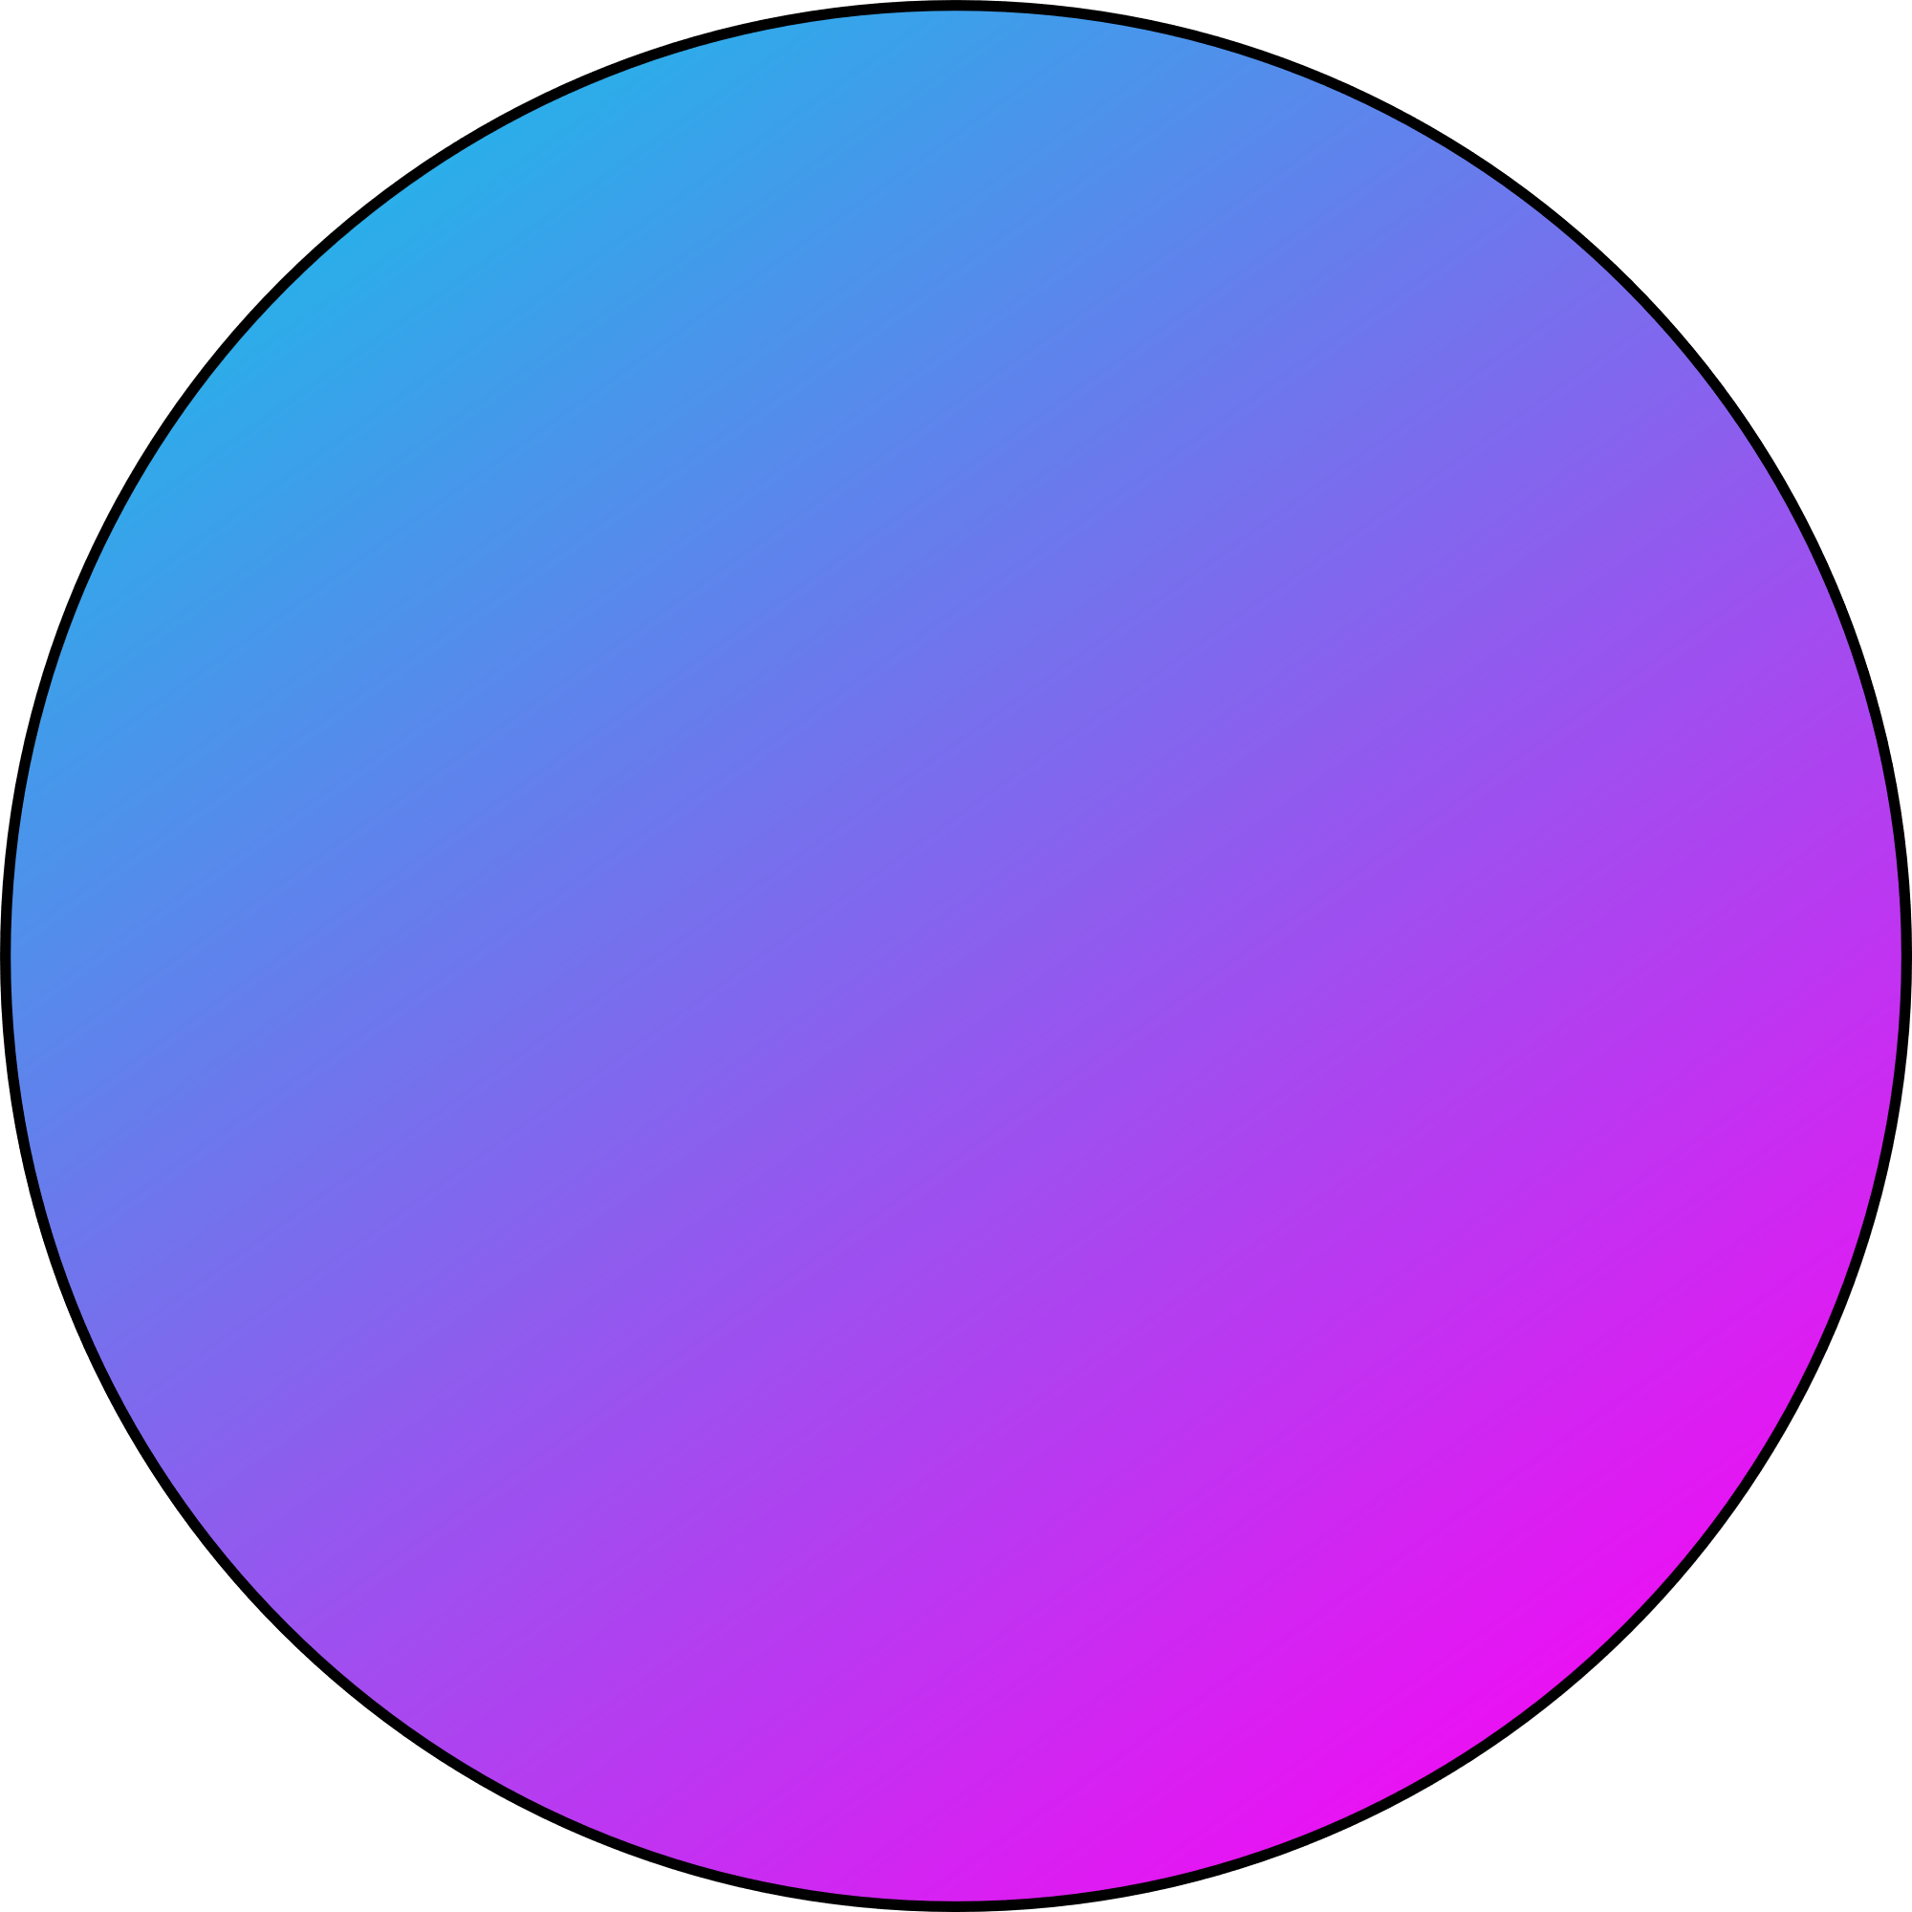
OBJECTIVE
01
To enhance energy efficiency
Enable remote control and monitoring through a cloud
02
Optimize heating schedules based on user preferences
03
Integrate safety features such as leak detection and automatic shutdown
04

Slide 5


EXISTING SYSTEM
Involve traditional water heaters with manual controls lacking remote accessibility or smart features.
Users typically manually adjust temperature settings without real-time monitoring or automation
Integrating IoT enhances the system by providing connectivity
Allowing users to control and monitor the water heater remotely
Implement energy-efficient scheduling
Incorporate safety features through sensors and alerts

Slide 6
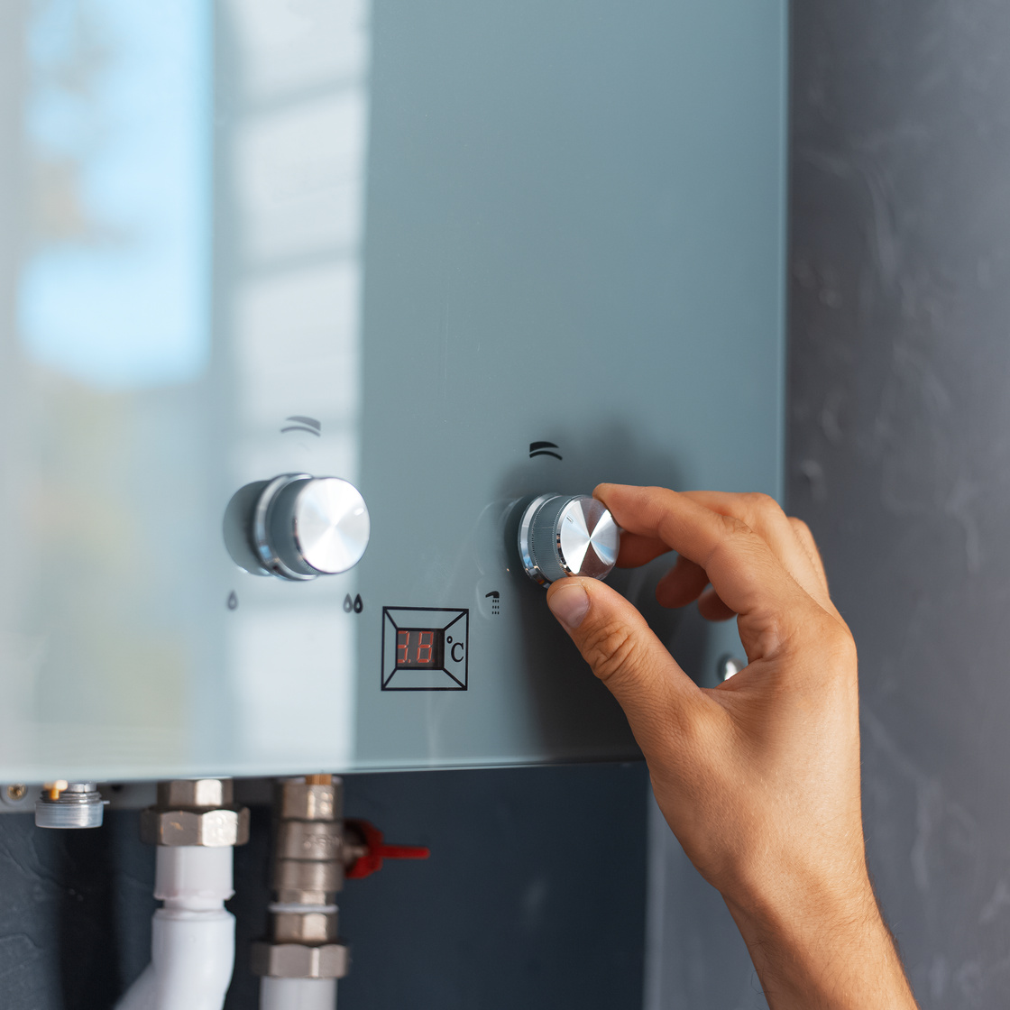
PROPOSED SYSTEM
The proposed IoT-based smart water heater system enhances efficiency, convenience, and control by integrating advanced technology components.
The mobile app allows users to monitor real-time data, set heating schedules, and control the heater remotely.
The system uses a relay module to control the heating element, automatically turning it off if the temperature exceeds a predefined safety limit, with notifications sent to the user via the Blynk app

Slide 7

TECHNOLOGIES USED
Microcontrollers/Processors
Connectivity Protocols
IoT Platform
Sensors
Web Interface
Cloud Computing
Security Measures
Power Management
Integration with Smart Home Ecosystems

Slide 8
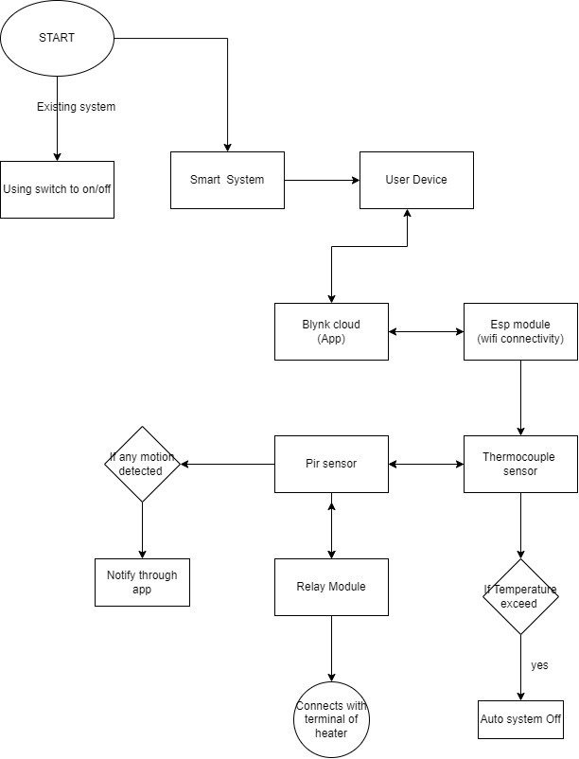
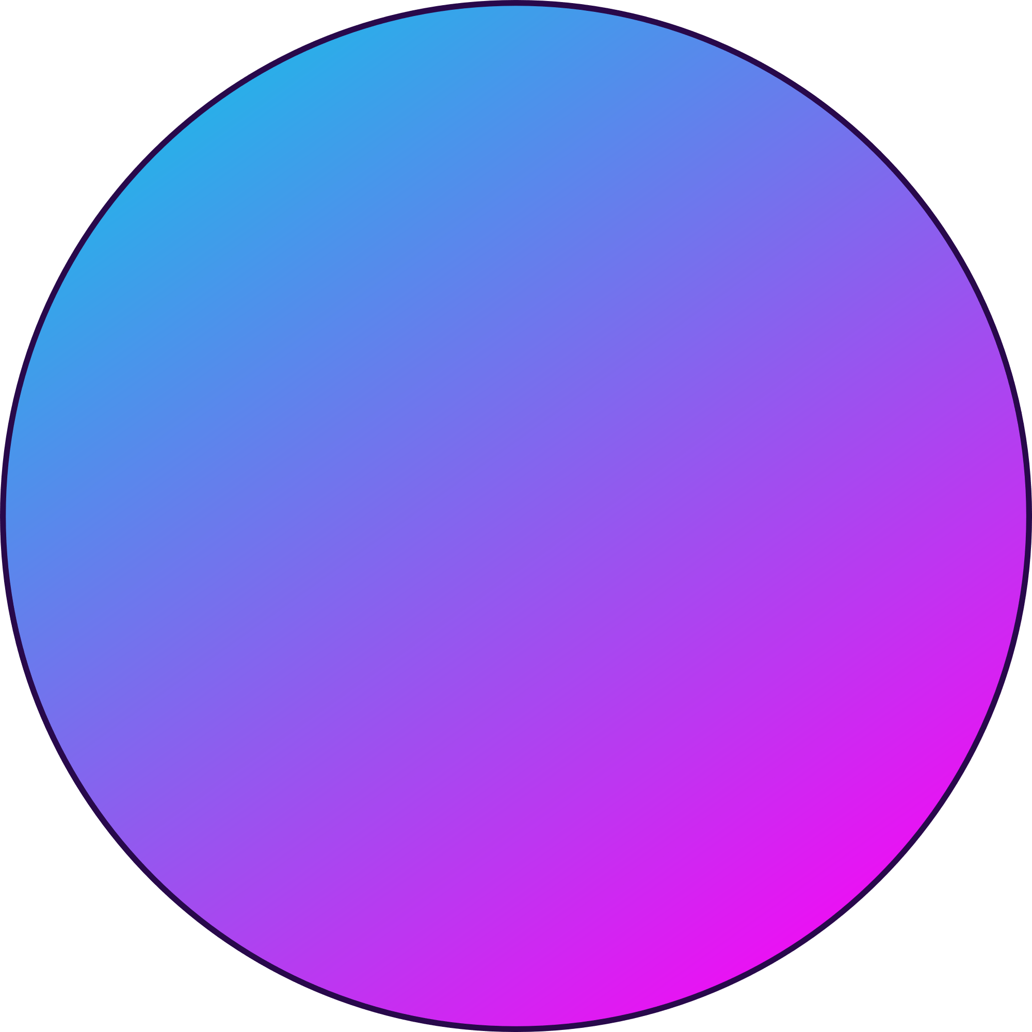
SYSTEM
ARCHITECTURE

Slide 9
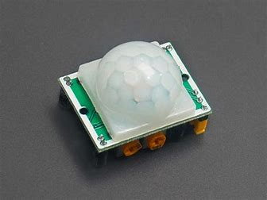
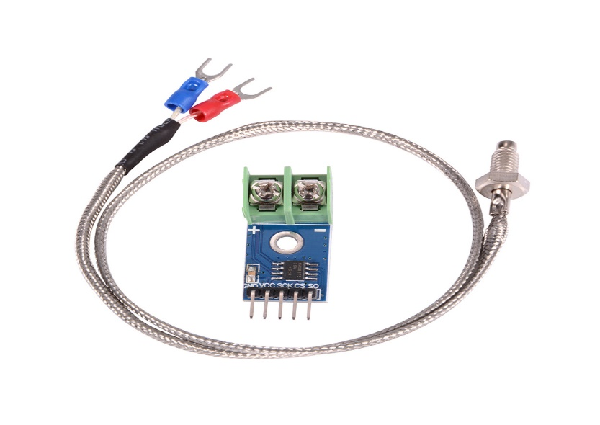
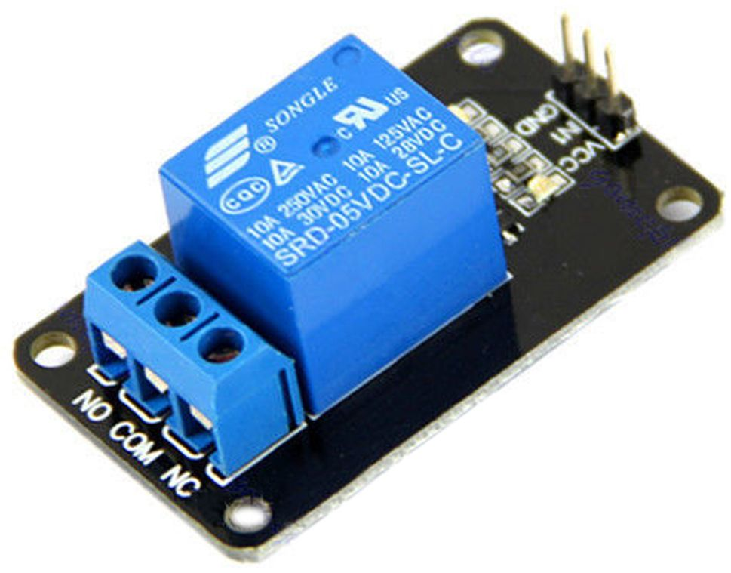
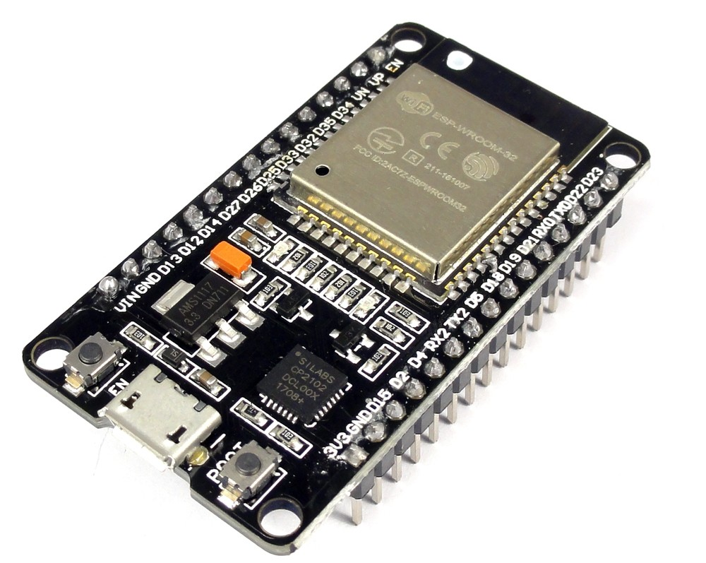
Components
PIR SENSOR
Thermocouple sensor
Relay module
Jumper cables
BreadBoard
Blynk IOT
ESP32

Slide 10
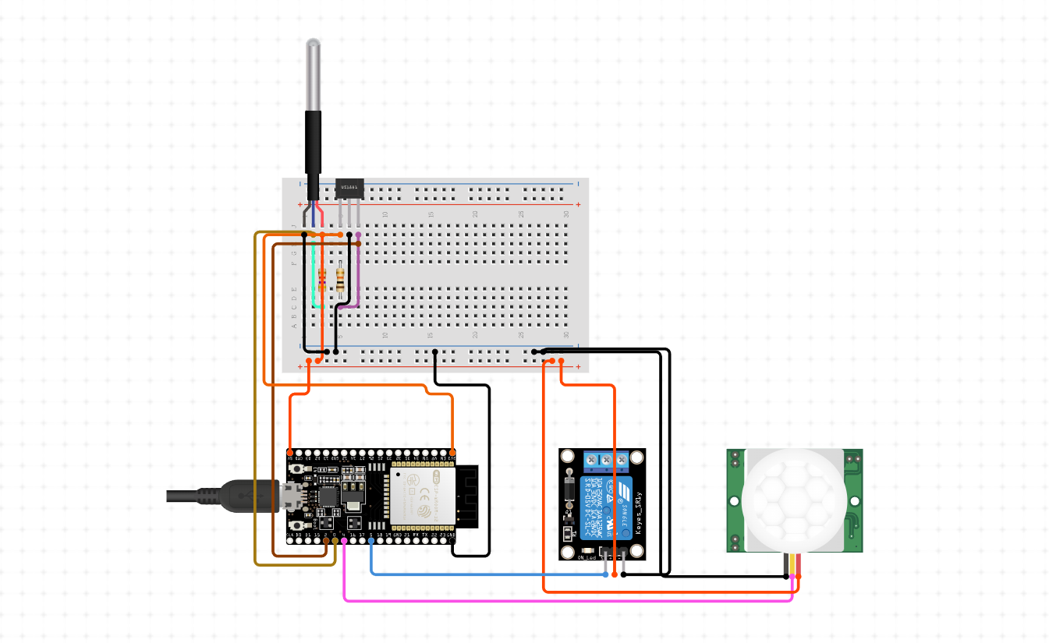
CIRCUIT DIAGRAM

Slide 11

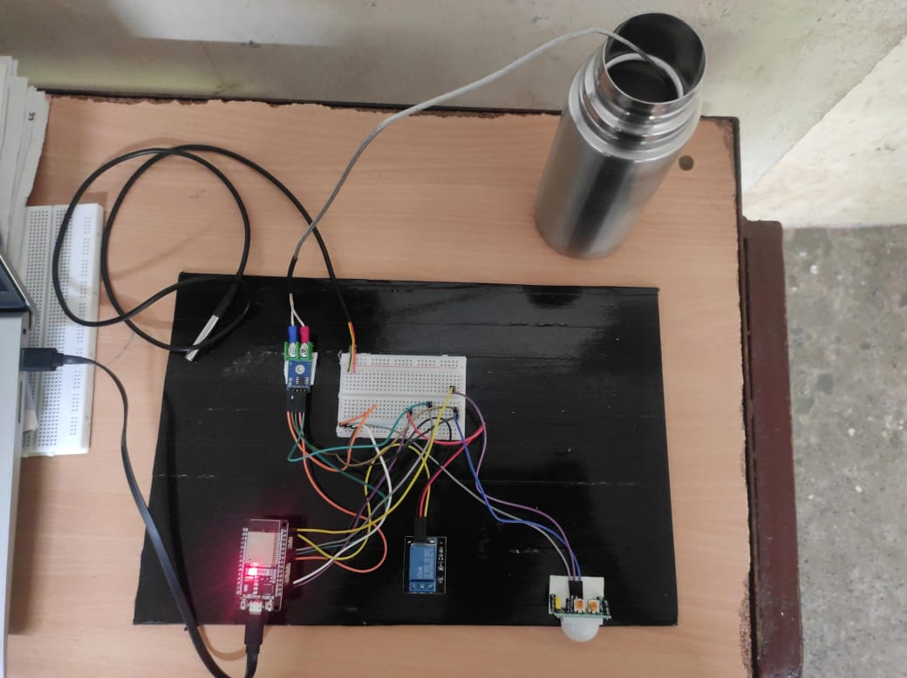
WORKING MODEL

Slide 12
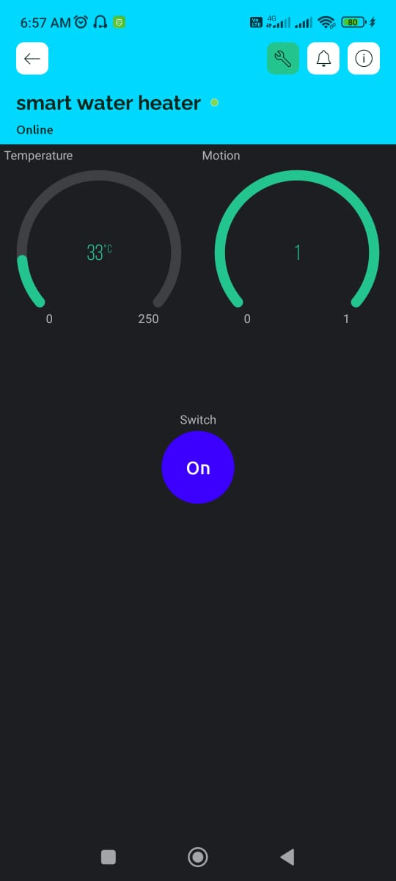
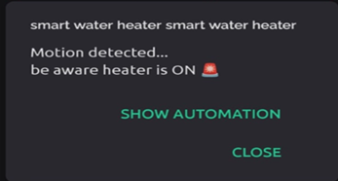
OUTPUT

Slide 13
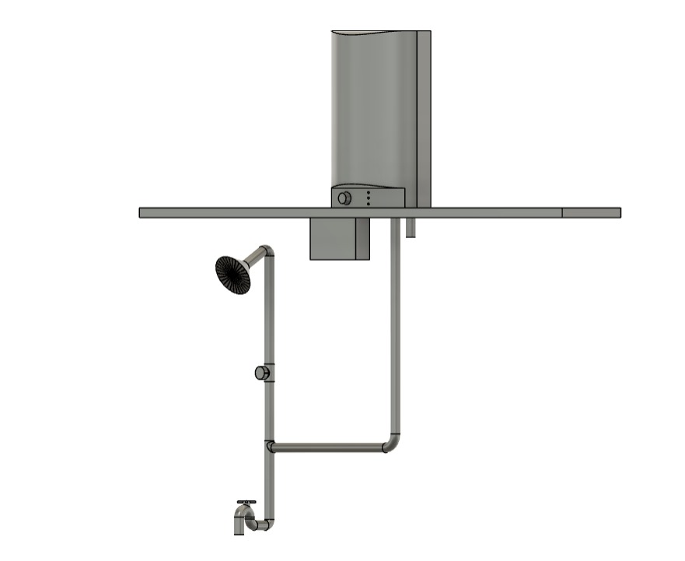
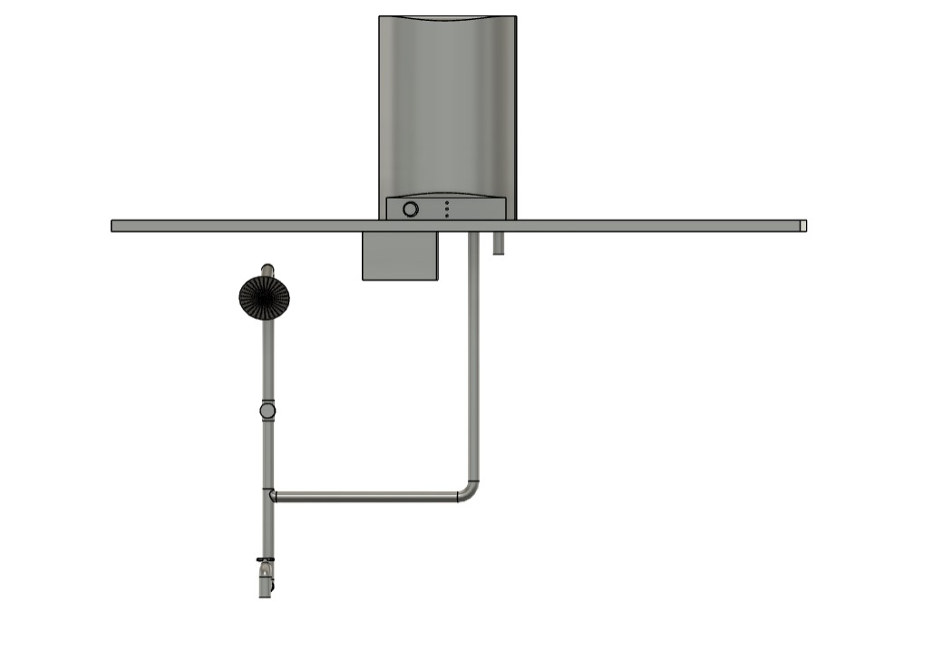
PROTOTYPE

Slide 14

MODULES USED
1. Sensor Module
2. User Interface Module
3. IoT Platform Integration Module
4. Automation and Optimization Module
5. Security Module
6. Power Management Module

Slide 15
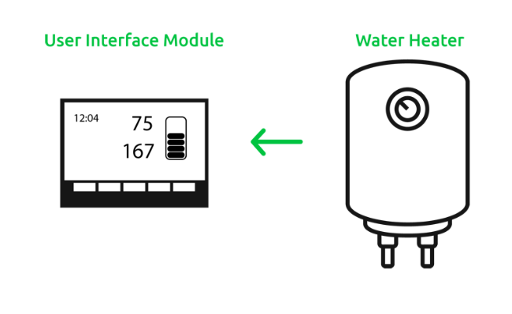
CASE STUDY
Customer need:
The customer had developed a wide range of smart water heaters to which they needed to add innovative 21st-century capabilities, greater market synergies, enhanced control, and a seamless end-user experience. They partnered with Softdel to develop a next-gen touchscreen-based user interface module that could be utilised across their family of water heaters and thereby, would give them a strong competitive advantage.
Solution:
Softdel developed an intuitive touch screen display (4.3 x 7-inch LCD with an LED backlight) and a capacitive touch panel. The design team had worked closely with customer team to capture market feedback and customer needs and integrate them into the prototypes.
Softdel’s solution assisted in automated test execution, log file creation, and test report management.
A cloud-based web application was built for monitoring critical water heater parameters, including temperature and energy consumption.
Additionally, Softdel supported the cloud-based interface with features like remote monitoring and control, performance tracking, alarm generation, and inventory optimisation
01

Slide 16
References
https://www.softdel.com/
Morse, Hanaa F., Maha S. AlGhamdi, Hussah M. Almu saied, Shouq A. Alsu baie, Dalal M. Almarri, Manal A. Alqah tani, Rasha A. Alqahtani, Rania A. Tabeidi, and Taghreed Bal harith. "The Smart Heater Based on Internet of Things." In The International Conference on Artificial Intelligence and Computer Vision, pp. 145-153. Cham: Springer International Publishing, 2021.
Sripriya, T., B. Muthu raj, D. Sateesh Kumar, V. Venkatesh, Badi reddy Satya Sridevi, Munaga Masthan Siva Krishna, K. Rajan, and Abdi Diriba. "Deep Learning-Based Smart Hybrid Solar Water Heater Erection Model to Extract Maximum Energy." International Journal of Photoenergy 2022 (2022).
Khairunnas, M. D., Ariyanto, E., & Prabowo, S. (2018, May). Design and implementation of smart bath water heater using Arduino. In 2018 6th International Conference on Information and Communication Technology (ICoICT) (pp. 184-188). IEEE.

Slide 17
THANK
YOU

